Slide 1
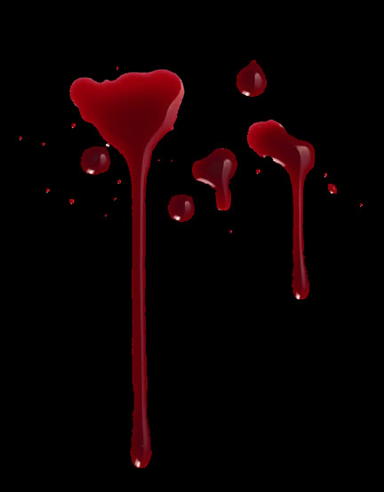
Developed by Tamara Hanford Scholtz

Slide 2
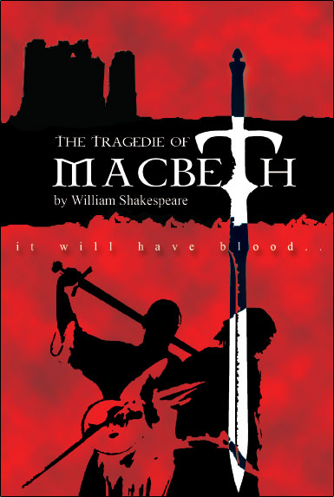
Macbeth
Written by William Shakespeare
His shortest play
His darkest and bloodiest Tragedy
Macbeth is the last of Shakespeare’s four great tragedies, the others being Hamlet, King Lear and Othello.

Slide 3
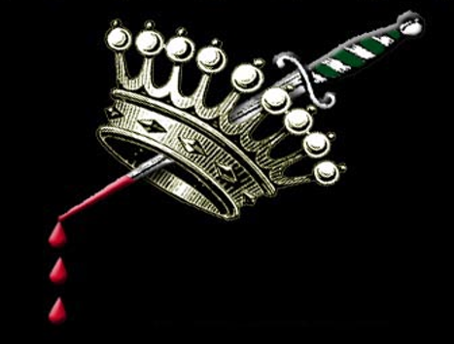
Anticipation Guide

Slide 4
Move each answer to the side which best represents your thoughts.
Have you ever given in to temptation?
NO
Do you believe in prophecies?
YES
What goes around comes around (karma).
Would you break your moral code for a loved one?
Do you listen to your conscience?
Behind every great man is a great woman
Success is worth any price you have to pay.

Slide 5
Choose two statements, explain why you made that choice.
Statement here
Statement here
Reason(Why you believe this): Evidence (Concrete from current events, personal experience, history, literature, sports, science): Commentary (How does your evidence and reason show you’re correct):
Reason(Why you believe this): Evidence (Concrete from current events, personal experience, history, literature, sports, science): Commentary (How does your evidence and reason show you’re correct):

Slide 6
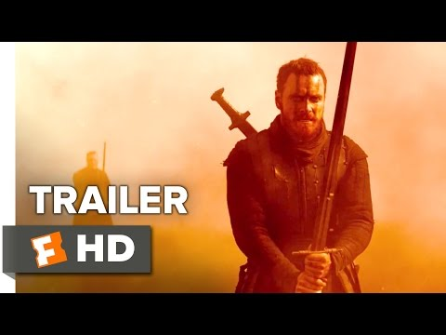
Watch video. Click on link if it doesn’t work.

Slide 7
Reflection
What did you notice about the movie trailer?
How could it apply to any of the anticipation guide?

Slide 8
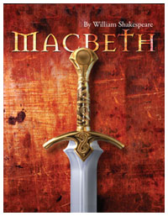
Movie trailer and transition
What are your thoughts on the movie trailer?
How do they relate to the anticipation guide?
WEBQUEST: Research

Slide 9
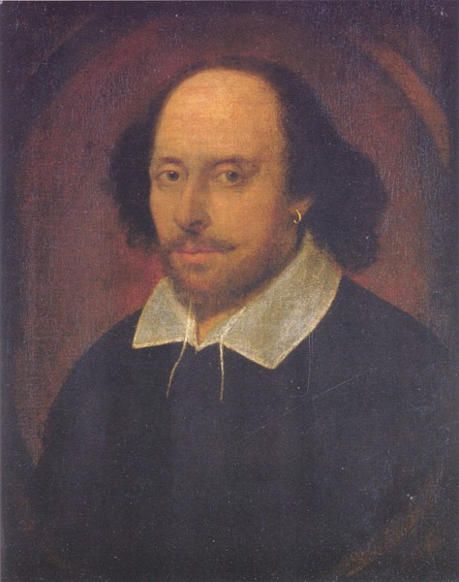
The Man Who Would Be Shakespeare
Give any five facts about Shakespeare

Slide 10
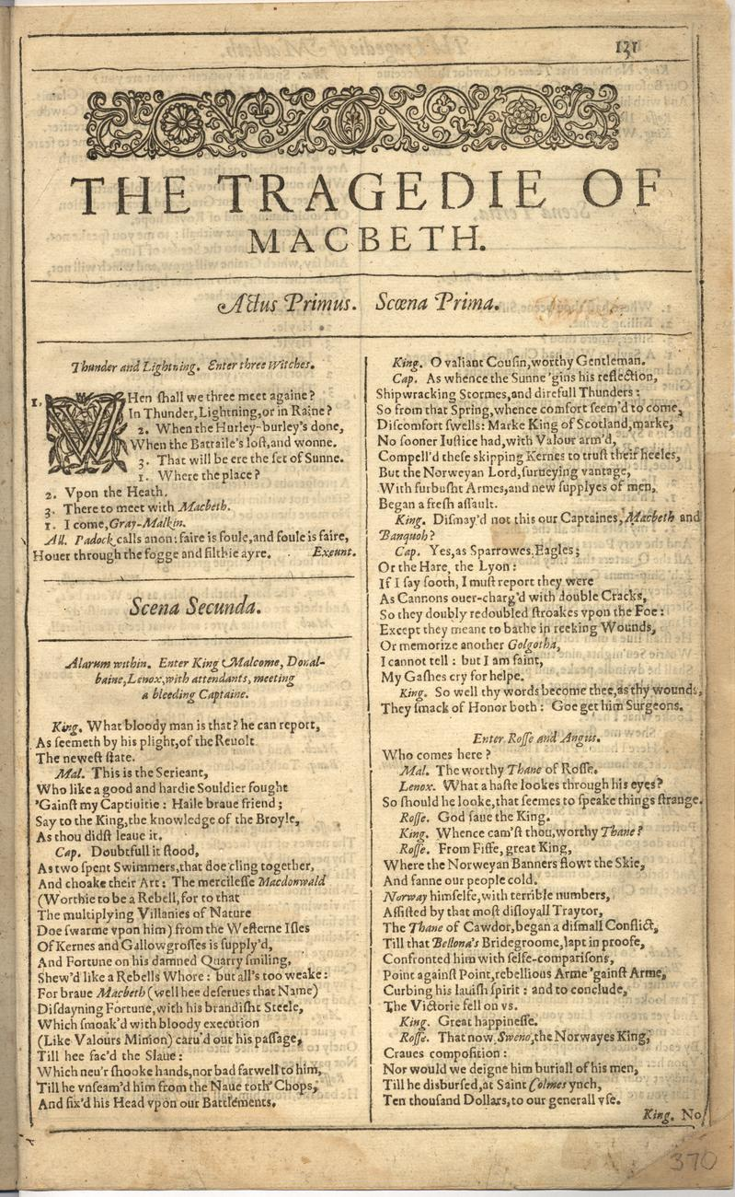
The Tragedy of Macbeth
Who was king of England when Shakespeare wrote Macbeth?
What is the setting for the play?
What was Shakespeare's source?
Which character was an ancestor of the King?

Slide 11
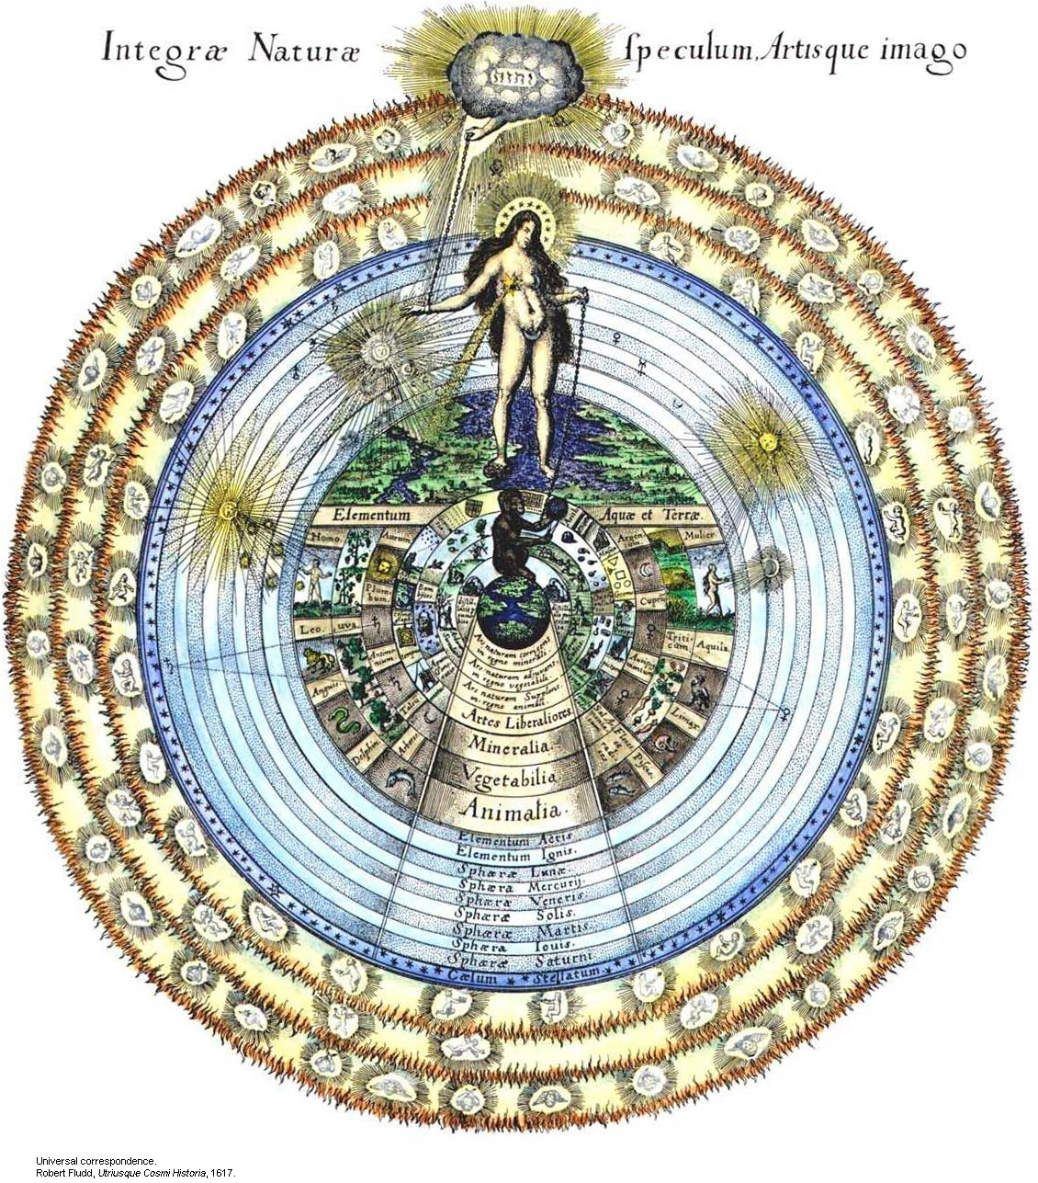
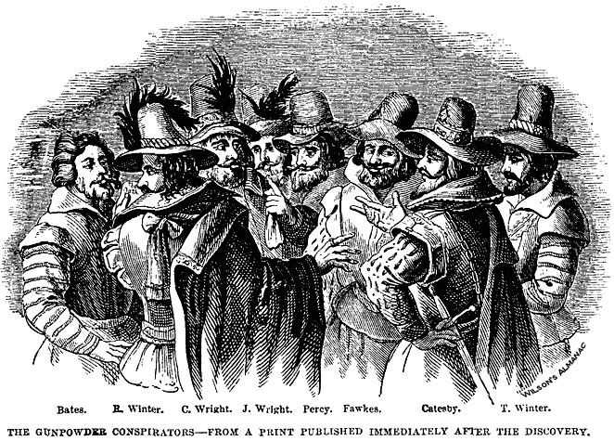
An Appeal to Elizabethan Interests
The play reflects the Elizabethan belief that the country is stable only if the King is good and virtuous
Elizabethans believed that evil occurs in darkness, which is a recurring motif in Macbeth
The play was considered a thriller based on current events—an allusion to the Gunpowder Plot of 1605

Slide 12
Give a summary of the Gunpower plot

Slide 13
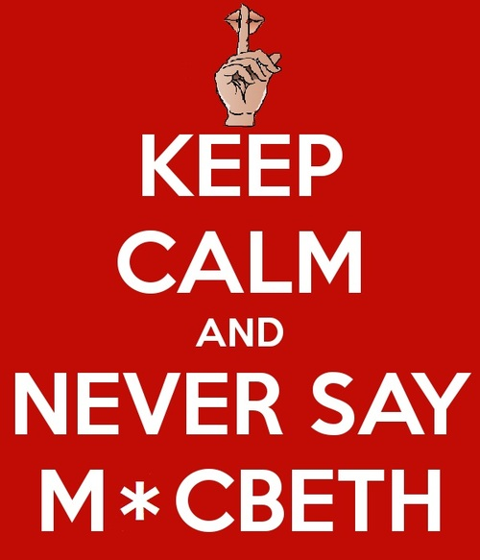
The Curse: Look it up. What’s this about?
Type here:

Slide 14
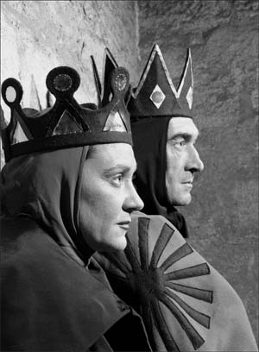
Language

Slide 15
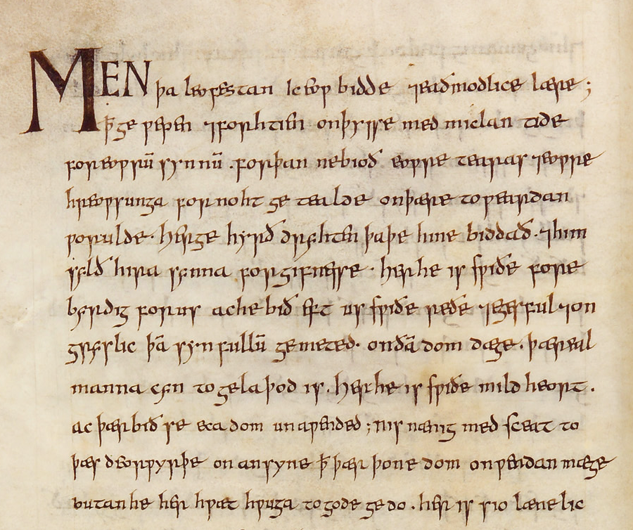
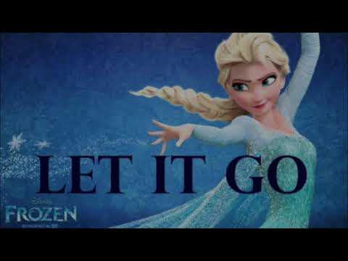
Just so you know, SHAKESPEARE isn’t old English; this stuff that’s written on the left is old English. Shakespeare is modern, BUT since he wrote in blank verse (10 syllables per line) and in iambic pentameter, AND in the 1500s, it’s different than our current type of language and it takes some work to understand it. Want to hear what OLD English sounds like? Click here.

Slide 16
Pronouns: Thee, Thou, Thine, Thy, Mine
Translation
Examples and Practice: Write the correct modern pronoun in each blank.
Thee, Thou = You
Thine, Thy = Your
Mine = My or Mine
Ex: “So well thy words become thee as thy wound.”
“So well _________ words become ______________ as _______________ wound.”
Ex: “Bring me mine armor!”
“Bring me ___________ armor!”

Slide 17
Perhaps you will notice that Shakespeare uses both the archaic and modern versions of the pronouns together. There seem to be no hard and fast rules for when to use one or the other but consider the following.
Thine tends to precede a vowel (thine armor) while thy precedes a consonant (thy sword)
You and Your tend to be less formal than thee and thou but notice in the following exercise that all can be used simultaneously.
Exercise: Consider the use of the second person pronouns in the following passage. Consider any shift in subject or tone that might explain the shift away from the you form to the thou form.
Was the hope drunk
Wherein you dress’d yourself? Hath it slept since?
And wakes it now, to look so green and pale
At what it did so freely? From this time
Such I account thy love. Art thou afeard
Which thou esteem’st the ornament of life,
And live a coward in thine own esteem,
Letting ‘I dare not’ wait upon ‘I would,’
Like the poor car I’ the adage?
(Macbeth Act II, Scene ii)
What do you think is happening in this passage? Translate it the best you can.

Slide 18
Suffixes and Verbs: -est, -st, -eth, -th, -t
A second distinctive characteristic of Elizabethan English is the frequent use of prefixes and, especially, suffixes. Some of the suffixes can be explained by the evolution of the language while others are the result of the poet’s pursuit of variety in expression. Fortunately, the common suffixes of this lesson est, st, eth, th are applied to fairly obvious verbs. In modern English these endings have mostly been simplified to the modern suffix s or dropped altogether. Translation: Est, st, eth, th, t = s or nothing at all
Examples and Practice: Find the suffix in each line and translate the sentence to modern English.
1. “Fly, good Fleance, fly, fly, fly! Thou mayest revenge!” 2. “False face must hide what the false heart doth know.” 3. “What he hath lost noble, Macbeth hath won!” 4. “He can report,/ As seemeth by his plight, of the revolt/ The newest state.” 5. “I have thee not, and yet I see thee still. Art thou not, fatal vision, sensible to feeling.” 6. “Thou can’st not say I did it: never shake thy gory locks at me.”
1.
2.
3.
4.
5.
6.

Slide 19
Contractions and Prepositions: I’, O’, Ne’er, E’er, O’er
Contractions in Shakespeare represent a challenge to the modern reader mainly because Shakespeare used them so freely, while in Modern English the use of contractions in formal writing is frowned upon. Contractions are indicated by the apostrophe ( ‘ ) which shows that letters have been left out. Most frequently, you will find that suffixes and prepositions have been contracted. Shakespeare varies his use of contractions to achieve poetic effect to sometimes, to make a pun.
Examples and Practice: Highlight the contraction and write its meaning below.
1. “Knock, knock, knock!” Who’s there, I’ the name of Beelzebub?”
_______in__________________ 2. “The Prince of Cumberland! That is a step/ On which I must fall down, or else o’erleap.” _________________________
3. “Merciful heaven! What, man! Ne’er pull your hat upon your brows!” _________________________
4. “No man that’s born of woman shall e’er have power upon thee.” _________________________
5. “Yet do I fear thy nature; it is too full o’ the milk of human kindness to catch the nearest way.” _________________________

Slide 20
Word Order: Auxiliary Dummy Do, Interrogatives, and Negation
The most formidable challenge in reading Shakespeare is coping with unusual sentence structures that are far removed from the typical subject -🡪 verb 🡪 object order in English. Some of these differences can be explained by the way in which questions are sometimes formed in Elizabethan English. The first problem is that the Elizabethans can (but don’t have to) form questions without do when modern
English demands a do. Secondly, they do this by placing the verb before the subject. This is particularly true when an interrogative is negative.
Translations:
To translate an unfamiliar question in Shakespeare, try adding do and checking to see if the subject is in front of the verb.
Important Grammar notes:
Auxiliary Verb: A verb that is used with a main verb. Be, do, and have are auxiliary verbs. Can, may, and must are modal auxiliary verbs.
Interrogatives: A structure to ask a yes/no question (Can you go?) or a wh-question (When can you go?)
Examples and Practice: Translate the following sentences into modern English.
1. Hath he ask’d for me? 2. Know you not he has? 3. Is execution done on Cawdor? Are not/ Those in commission yet return’d? 4. Dismay’d not this our captains, Macbeth and Banquo? 5. Goes Fleance with you? 6. Sirrah, a word with you: attend those men/ Our pleasure?

Slide 21
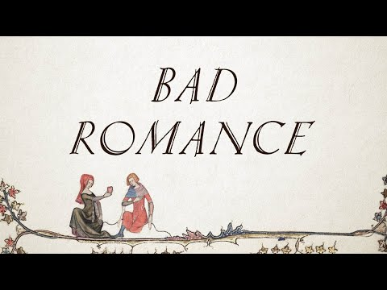
Bardcore: Really, it’s a thing!!!
Lyrics (“Bad Romance” Bardcore)
I want thine ugly, I want thy disease Take aught from thee shall I if it can be free I want thy love Love, love, love, I want thy love I want thy heartache, the touch of thy hand For weal or woe, I want each kiss in the sand I want thy love Love, love, love, I want thy love I want thy love, and all thy lover’s revenge Thee and me could write a bad romance I want thy horror, I want thy design thou art a criminal whilst thou art mine I want thy love Love, love, love, I want thy love I want thy Nero, thy Bedlam lament, If this is sin then I shall never repent, I want thy love Love, love, love, I want thy love
Click here for the link

Slide 22
You try it! Choose a portion of a school appropriate song, and change the lyrics
Original lyrics
Bardcore version

Slide 23
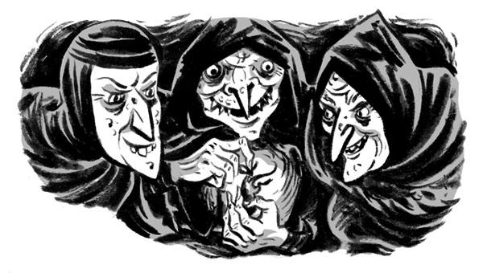
The basics

Slide 24
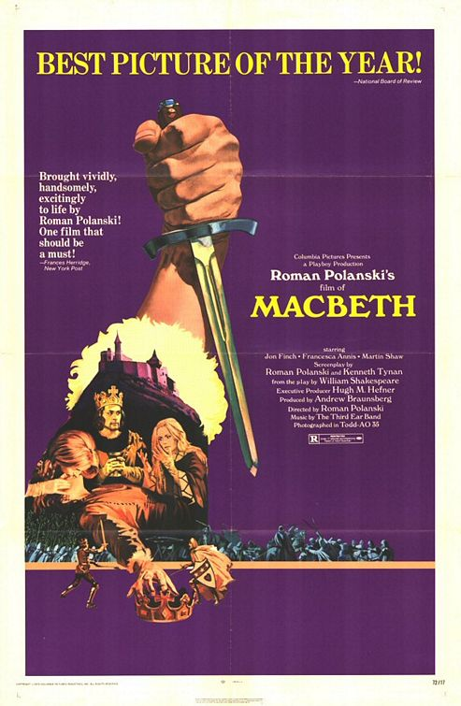
Historical Context
Macbeth was a real king of Scotland
He did kill King Duncan
Reigned from 1040-1057
Unlike the Macbeth in Shakespeare’s play
The real Macbeth had a legitimate claim to the throne
The real Macbeth was a strong leader
The real Macbeth’s reign was successful

Slide 25
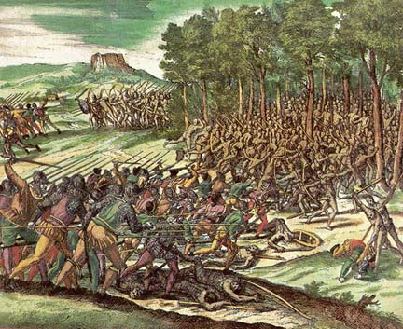
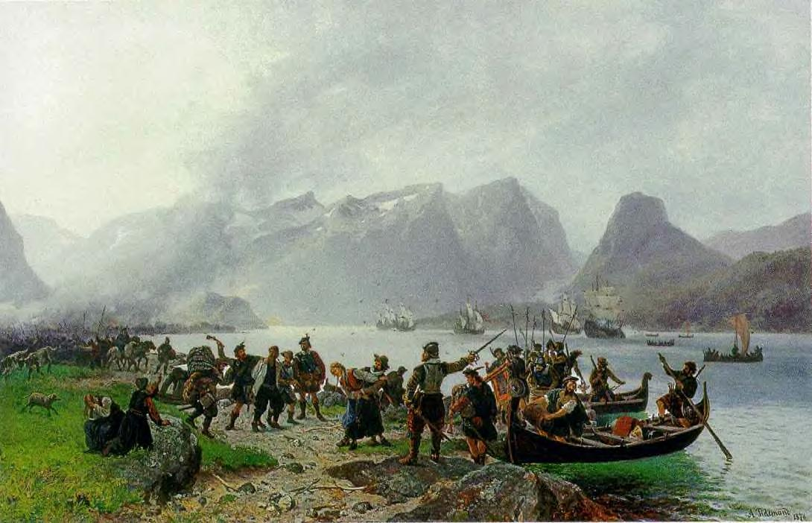
Before the Curtain Opens
When the play begins, there are two wars in progress:
Civil War: King Duncan vs. Macdonwald’s rebels
National War: Scotland vs. Norway

Slide 26
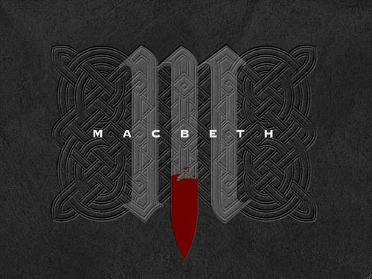
Overview
Macbeth is a brave Scottish general
He receives a prophecy from 3 ghastly witches that someday he will become the king of Scotland
He and his wife become consumed with thoughts of glory and power

Slide 27
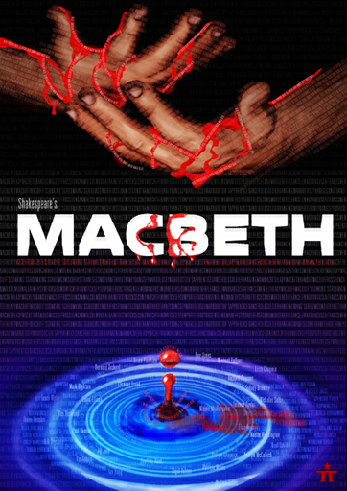
Literary Focus
Topics and Conflicts
Ambition
Corruptive nature of Power
Guilt
Paranoia
Aggression and Masculinity
Fate and Prophecy
Super Natural Phenomenon
Deterioration of the Human Mind

Slide 29
Quick Write
Prompt:
Use the five words below to make a prediction for Macbeth. What will the plot include? What might happen to the Main characters – Macbeth and Lady Macbeth (His Wife)? Try to do it in Shakespearean language.
Assassination
War
Witchcraft
Prophecy
Tyranny
Double click and type here:

